Slide 1
FY27 Proposed Budget Overview
City Manager Phil Crowell

Slide 2
KEY CONTEXT
Council directive: No new programs
Budget maintains current programs and services
Focus on sustaining operations and contractual obligations

Slide 3
ACTUAL
EXPENDED
BUDGET
FY24-25
COUNCIL
ADOPTED
BUDGET
FY25-26
MANAGER
PROPOSED
BUDGET
FY26-27
INCREASE
(DECREASE)
FROM PRIOR
YEAR BUDGET
% OF
INCREASE
(DECREASE)
Municipal Services
General Government |  | 7,698,584 | 8,850,771 | 8,842,375 | (8,396) |  | -0.09%
Fringe Benefits |  | 8,543,227 | 8,899,292 | 9,792,831 | 893,539 |  | 10.04%
Information Technology |  | 1,082,514 | 1,095,845 | 1,297,249 | 201,404 |  | 18.38%
Fire & EMS Transport |  | 6,813,374 | 6,770,859 | 7,151,110 | 380,251 |  | 5.62%
Police |  | 5,278,613 | 5,549,367 | 5,779,097 | 229,730 |  | 4.14%
Public Works |  | 8,306,265 | 8,262,820 | 8,446,766 | 183,946 |  | 2.23%
Solid Waste |  | 1,923,115 | 1,771,977 | 2,278,859 | 506,882 |  | 28.61%
Water & Sewer |  | 781,203 | 840,280 | 844,563 | 4,283 |  | 0.51%
Total Municipal Services |  | 40,426,895 | 42,041,211 | 44,432,850 | 2,391,639 |  | 5.69%
Notes:
General Government: Slight decrease (GA reduction)
Overall staffing reduced from 255.5 FTEs in FY26 to 253.5 FTEs in FY27 (Grant Positions)
Fringe Benefits: +11% health insurance increase
Information Technology: Software licensing fees – consolidated from all departments, increases
Fire/EMS: Union obligations, full-year funding for 3rd ambulance
Public Works: City Electrician moved from Planning & Permitting
Solid Waste: Year 2 of Casella contract, tipping fee $54→$88/ton (bin automation, tipping fee)

Slide 4
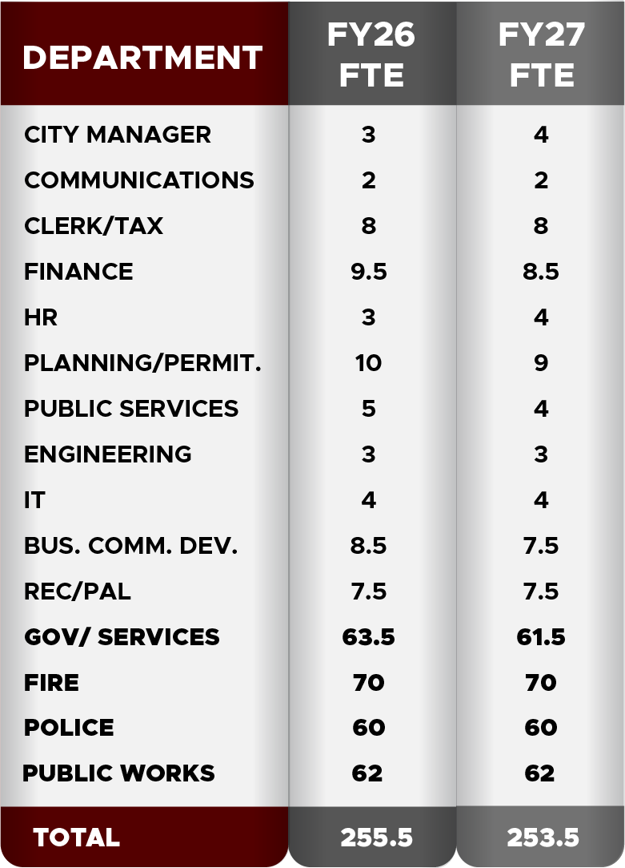
Employees
Full-Time

Slide 5
SOLID WASTE IMPACT
FY26
SW Disposal $516,500
SW Collection $720,000
Recyc. Disposal $91,000
Recyc. Collec. $288,000
Misc. Collec. $155,477
FY27
SW Disposal $812,220
SW Collection $900,914*
Recyc. Disposal $90,000
Recyc. Collection $455,525
Organic Waste $19,968
* Solid Waste Collection includes $312,000 for bin purchase/management (multi-year)

Slide 6
ACTUAL
EXPENDED
BUDGET
FY24-25
COUNCIL
ADOPTED
BUDGET
FY25-26
MANAGER
PROPOSED
BUDGET
FY26-27
INCREASE
(DECREASE)
FROM PRIOR
YEAR BUDGET
% OF
INCREASE
(DECREASE)
Fiscal Services
Debt Service |  | 9,592,857 | 12,259,977 | 17,642,234 | 5,382,257 |  | 43.90%
Emergency Reserve |  | 0 | 550,000 | 686,216 | 136,216 |  | 24.77%
Transfer to TIF |  | 3,627,253 | 3,272,673 | 3,627,253 | 354,580 |  | 10.83%
Total Fiscal Services |  | 13,220,110 | 16,082,650 | 21,955,703 | 5,873,053 |  | 36.52%
Notes:
Emergency Reserve: Charter compliance
Debt Service: +$4.38M for Public Safety Facility referendum, Merrow Road debt and Engine 2 Station debt

Slide 7
ACTUAL
EXPENDED
BUDGET
FY24-25
COUNCIL
ADOPTED
BUDGET
FY25-26
MANAGER
PROPOSED
BUDGET
FY26-27
INCREASE
(DECREASE)
FROM PRIOR
YEAR BUDGET
% OF
INCREASE
(DECREASE)
Intergovernmental Programs
County Taxes |  | 3,117,240 | 3,385,568 | 3,694,912 | 309,344 |  | 9.14%
Tax Sharing |  | 205,121 | 260,000 | 260,000 | 0 |  | 0.00%
Arts & Culture |  | 35,000 | 10,000 | 10,000 | 0 |  | 0.00%
Auburn-Lewiston Municipal Airport |  | 217,850 | 205,000 | 205,000 | 0 |  | 0.00%
Lew-Aub Transit Committee |  | 458,502 | 566,298 | 570,000 | 3,702 |  | 0.65%
Lew-Aub 911 Communications Center |  | 1,384,110 | 1,436,677 | 1,626,297 | 189,620 |  | 13.20%
Total Intergovernmental Programs |  | 5,417,823 | 5,863,543 | 6,366,209 | 502,666 |  | 8.57%

Slide 8
ACTUAL
EXPENDED
BUDGET
FY24-25
COUNCIL
ADOPTED
BUDGET
FY25-26
MANAGER
PROPOSED
BUDGET
FY26-27
INCREASE
(DECREASE)
FROM PRIOR
YEAR BUDGET
% OF
INCREASE
(DECREASE)
Total Intergovernmental Programs |  | 5,417,823 | 5,863,543 | 6,366,209 | 502,666 |  | 8.57%
Grand Total Municipal Expenditures |  | 59,064,828 | 63,987,404 | 72,754,762 | 8,767,358 |  | 13.70%
Non-Tax Revenues
Total Non-Tax Revenue |  | 26,142,646 | 27,172,975 | 27,607,544 | 434,569 |  | 1.60%

Slide 9
FY27 Financial Impact - % Change by Category
Intergovernmental:
6% $502,666
Overall Municipal Expenditures
increased by 13.7% [8,767,358]
Municipal
Services: 27%
$2,391,639
Fiscal
Services: 67%
$5,873,053
Notes:
$6,182,397 is the fixed costs (71%)
$2,584,961 is the recommended changes (29%)

Slide 10
Supplemental Considerations
 | Request | Revenue / Offset | Total Request
CITY ADMINISTRATION SUPPLEMENTAL CONSIDERATIONS
Maine Drug Enforcement Agent | 151,595 | 151,595 | -
Automatic License Plate Reader (FLOCK Cameras) | 24,000 | - | 24,000
CITY COUNCIL SUPPLEMENTAL CONSIDERATIONS
Parks Department - Councilor Walker | TBD | TBD | TBD
NON-MUNICIPAL SUPPLEMENTAL REQUESTS
LA Arts | 32,500 | - | -
Hailey Hugs | 100 | - | 100
Drop-In Center Services (revenue reduction 121 Mill Street) | 43,000 | - | 43,000
Life Flight | 2,000 | - | 2,000

Slide 11
Budget Schedule
* Tentative
Date | Event
February 2, 2026 | Joint City / School initial budget discussion
March 2, 2026 | Budget Workshop
March 9, 2026 | Special Budget workshop
March 10, 2026 | CM presents CIP to Planning Board
March 16, 2026 | CM Presents Preliminary FY27 Budget and 5-Yr CIP Plan Council Budget Workshop
March 23, 2026 | Special Budget Workshop
March 30, 2026 | CIP DEADLINE BY CHARTER TENTATIVE- Special Budget Workshop
April 6, 2026 | School Budget Presentation City Manager’s Final Budget Adopt 5-Year CIP Plan
April 20, 2026 | FY27 CIP Review
APRIL 30, 2026 | FINAL DAY TO SUBMIT MANAGER’S BUDGET TO COUNCIL BY CHARTER
May 4, 2026 | Adopt School Budget Public hearing and first reading on appropriation resolve and CIP bonding
May 18, 2026 | Second Reading on appropriation resolve and CIP bonding
June 30, 2026 | FINAL BUDGET ADOPTION DEADLINE BY CHARTER

